Slide 1
Instructions to users
2026-03-23

Slide 2
Content
1 Introduction
2 Installation
3 Export meshes and voxels
4 Running the tool

Slide 3
I Introduction
This tool is developed for identifying fire hazard. Currently the tool only support Revit 2018.

Slide 4
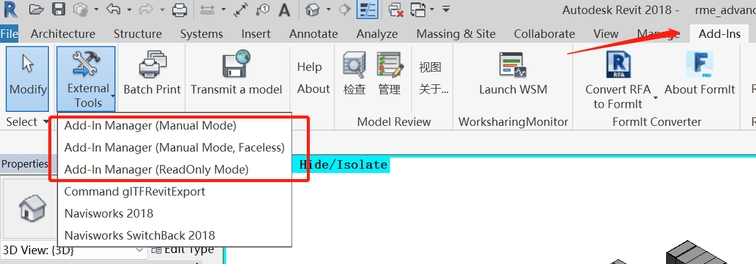
2 Installation
The tool is run by the Revit Addin Manager, which is an add-in for Revit. If you have not install the Addin Manager, please quit the Revit application, copy all the files in the AddinManager to the folder C:\ProgramData\Autodesk\Revit\Addins\[your Revit version]\, and restart the Revit application. Then you can find it appears in the Add-Ins Tabs

Slide 5
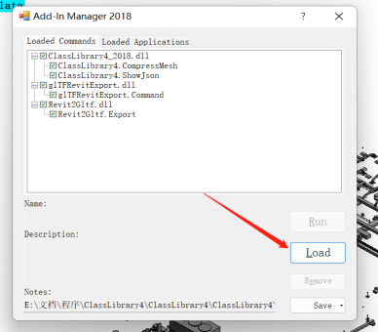
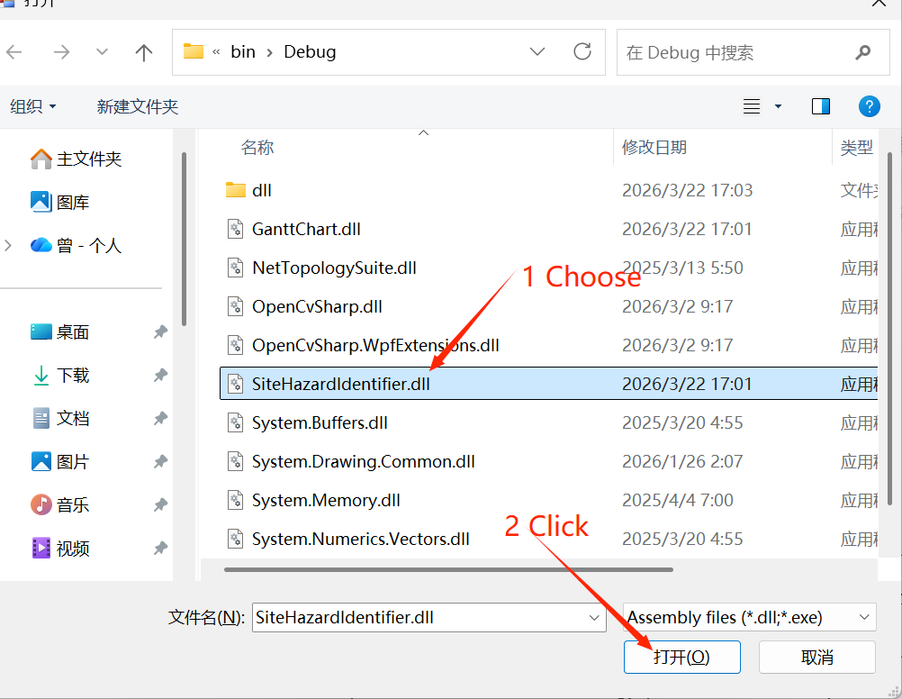
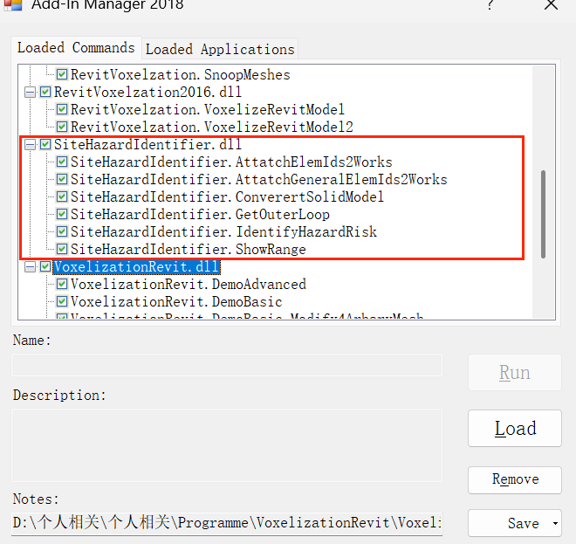
2 Installation
Click the “Add-In Manager（Manual Mode）” , Click “Load”, choose the SiteHazardIdentifier.dll of "Supplementary Materials\Compiled\Debug\" folder

Slide 6
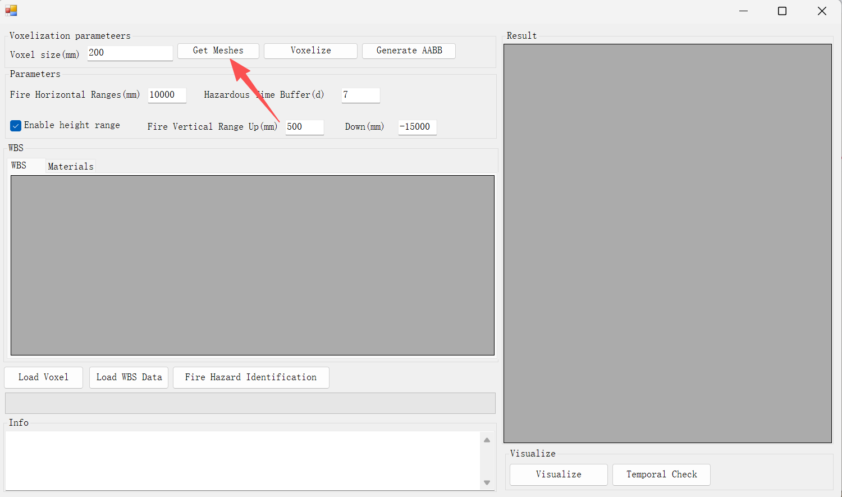
3 Export meshes and voxels
1st Export mesh
Click “Get meshes” to export meshes visible in current view.
Note: The elements in either the main model and the linked models can be exported.
The exported meshes are stored as a fireRiskData file. This is a zipped file and can be opened by compression tools such as winRAR.

Slide 7
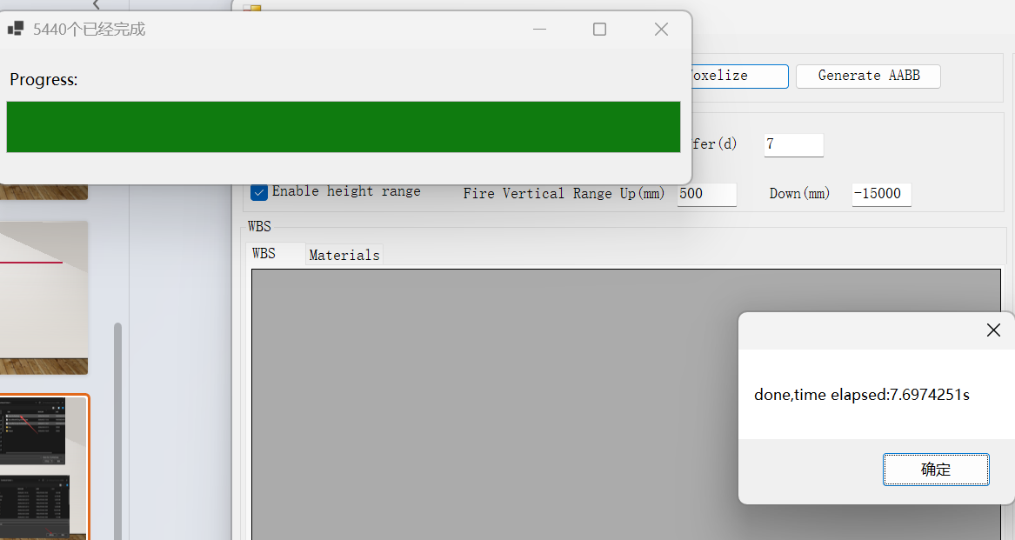
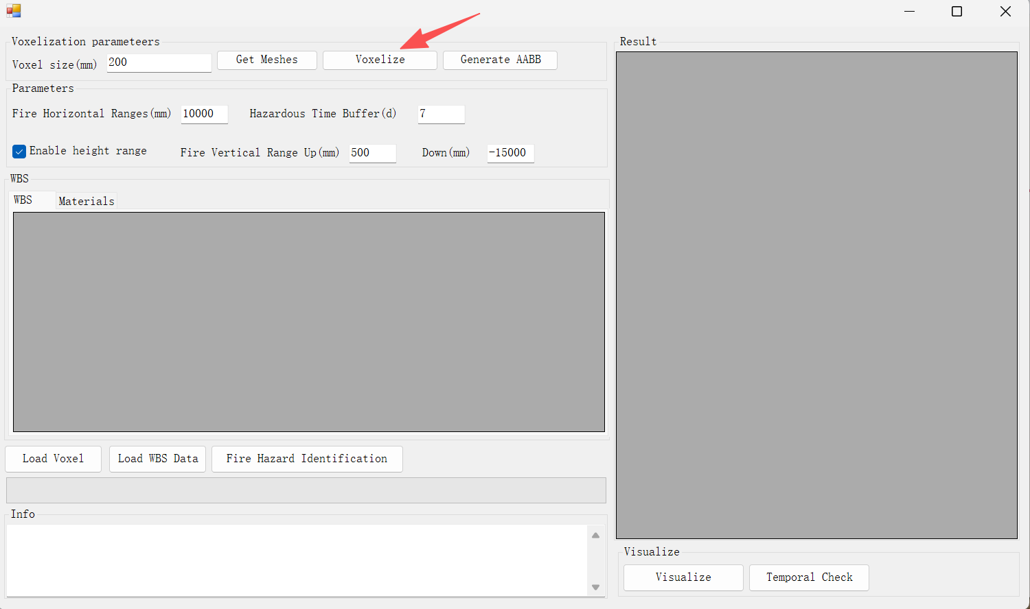
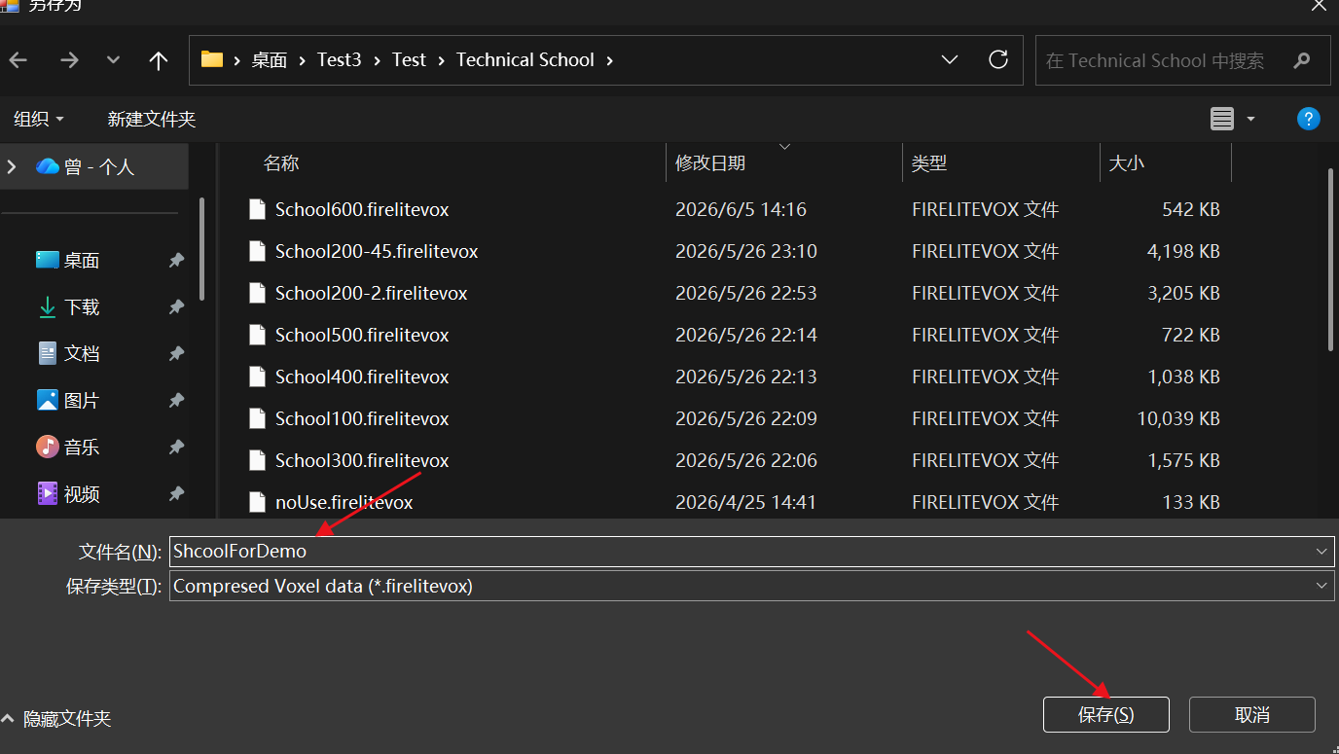
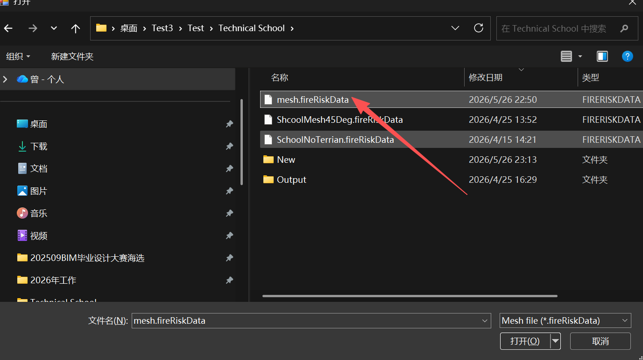
3 Export meshes and voxels
2nd Convert mesh to voxels
Click “Voxelize” .
Choose the mesh file exported in the previous step
Set a destination to save the voxel fire
Wait until the voxelization process is done.

Slide 8
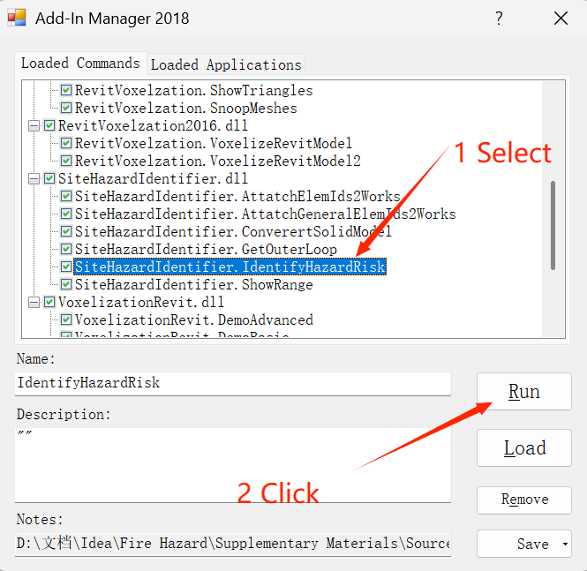
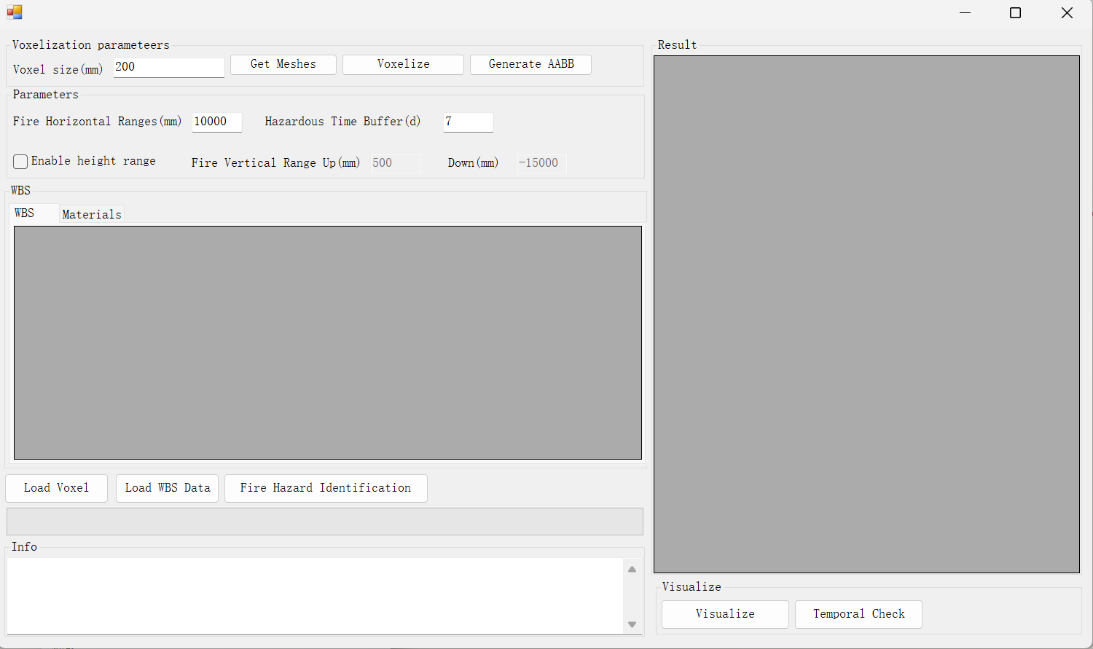
4 Running the tool
1st Select the SiteHazardIdentifier.IdentifyHazardRisk from the Add-in Manager, then click Run. The main form of the tool will appear.

Slide 9
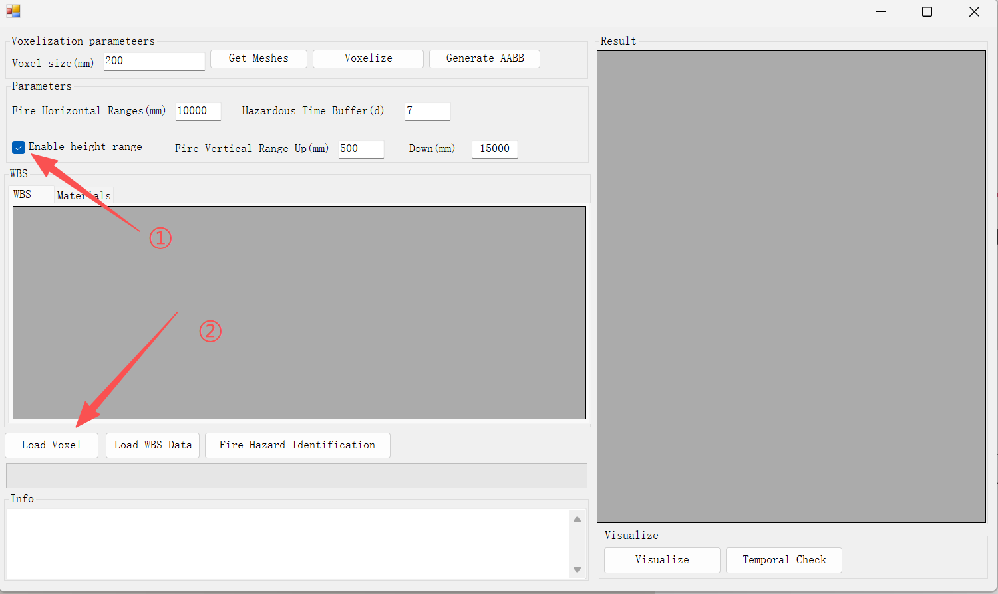
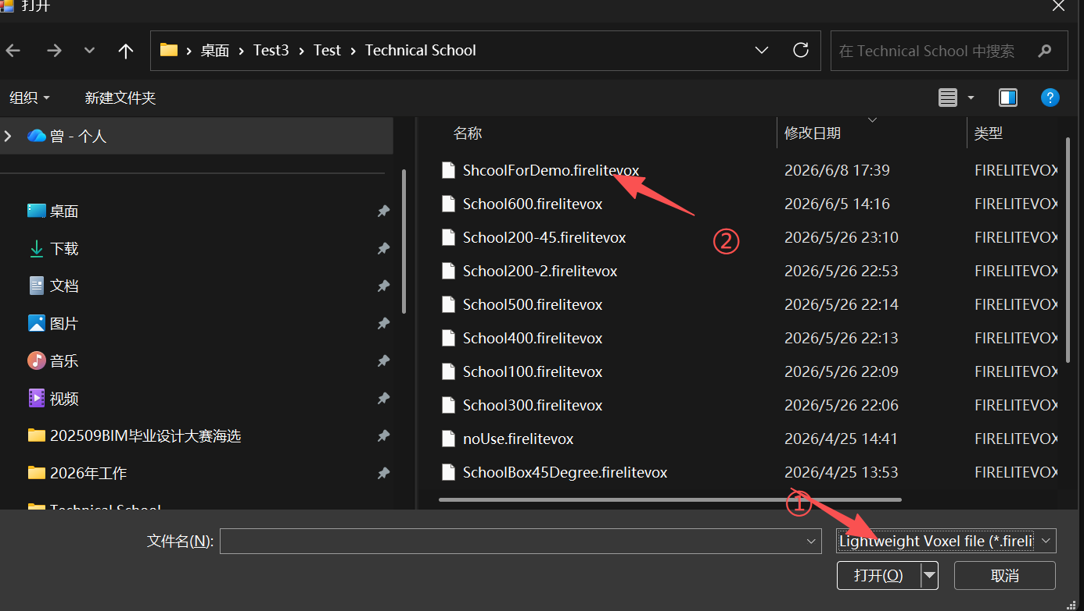
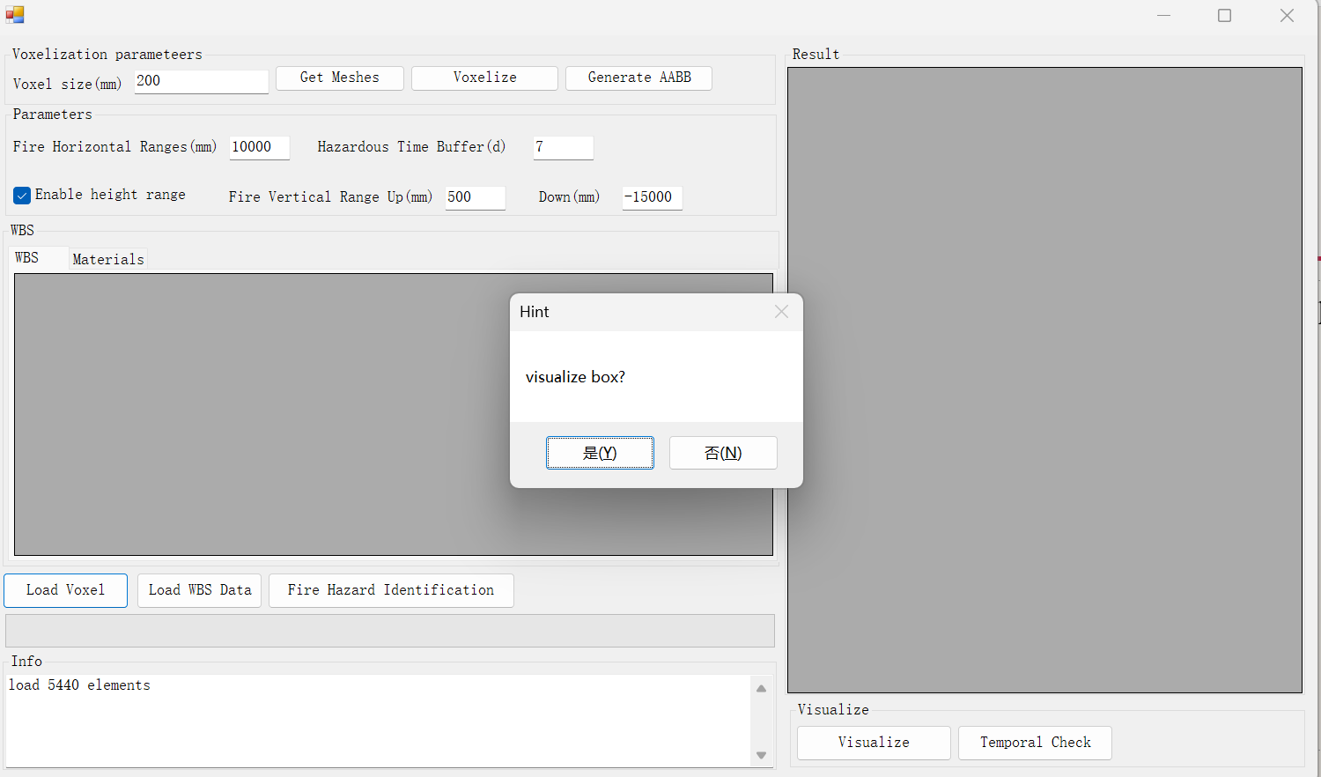
4 Running the tool
2nd click the “Load voxel”. Choose the fireLiteVox file exported previously . Wait until the voxels are loaded.

Slide 10
4 Running the tool
2nd（Optional）If you hope to visualize the voxel representation of the model, click “Yes”, otherwise,Click “No”. If the model is very large, visualizing the voxels may consume a large amount of time and resource, so it is not suggest to click Yes for larger BIM model.

Slide 11
4 Running the tool
3rd, Prepare for the WBS activities in csv format as follows, make sure the ID of each activity starts with “A”
ID | Name | Resource | Work type | ElementId | Start | End | Contains combustible substances(Yes/No) | Involve flames or Sparks or high-temperature(Yes/No) | Release flammable vapors or gases or liquids (Yes/No) | Reason(Less than 50 words.Use semicolons to replace commas)

Slide 12
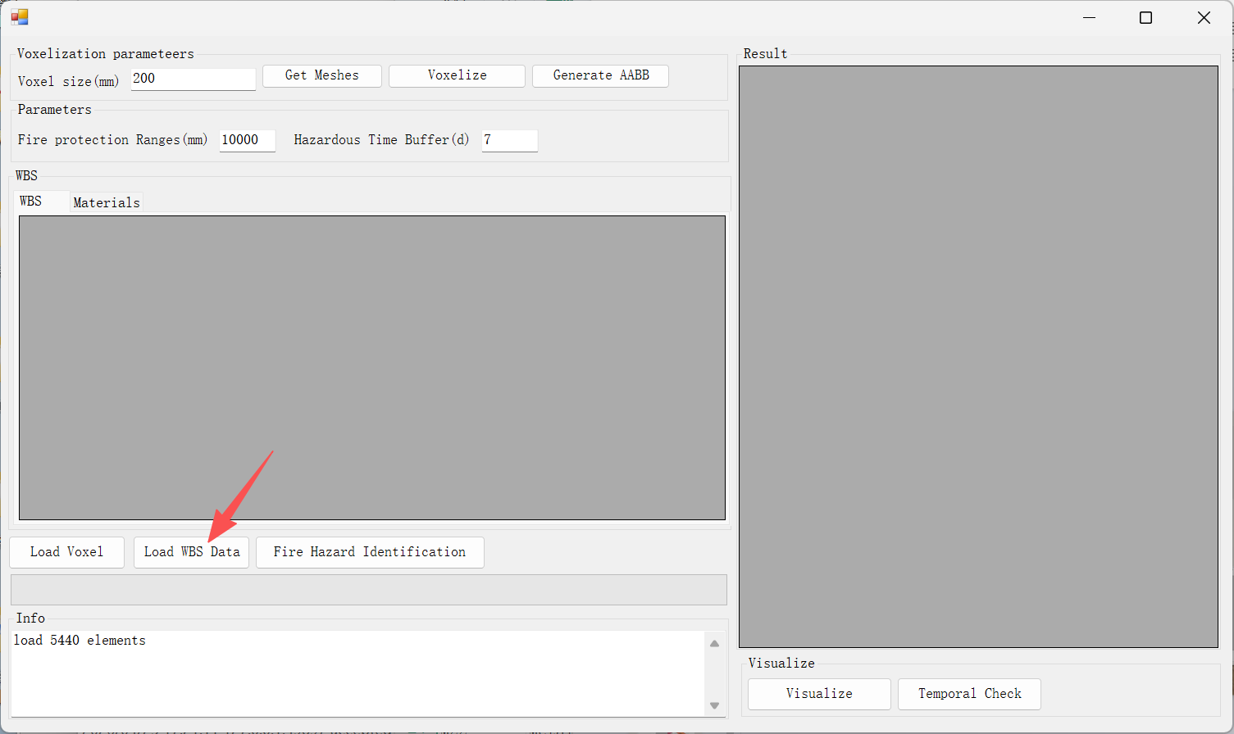
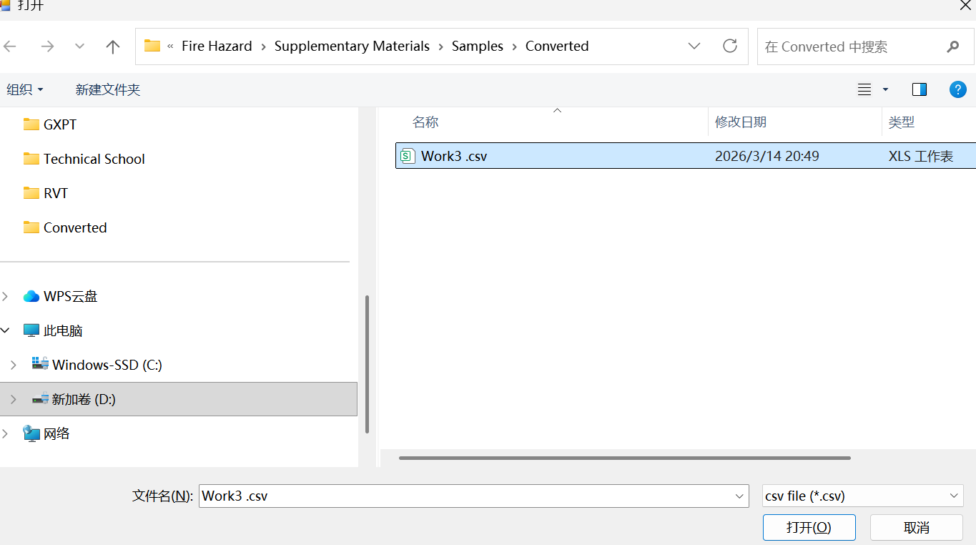
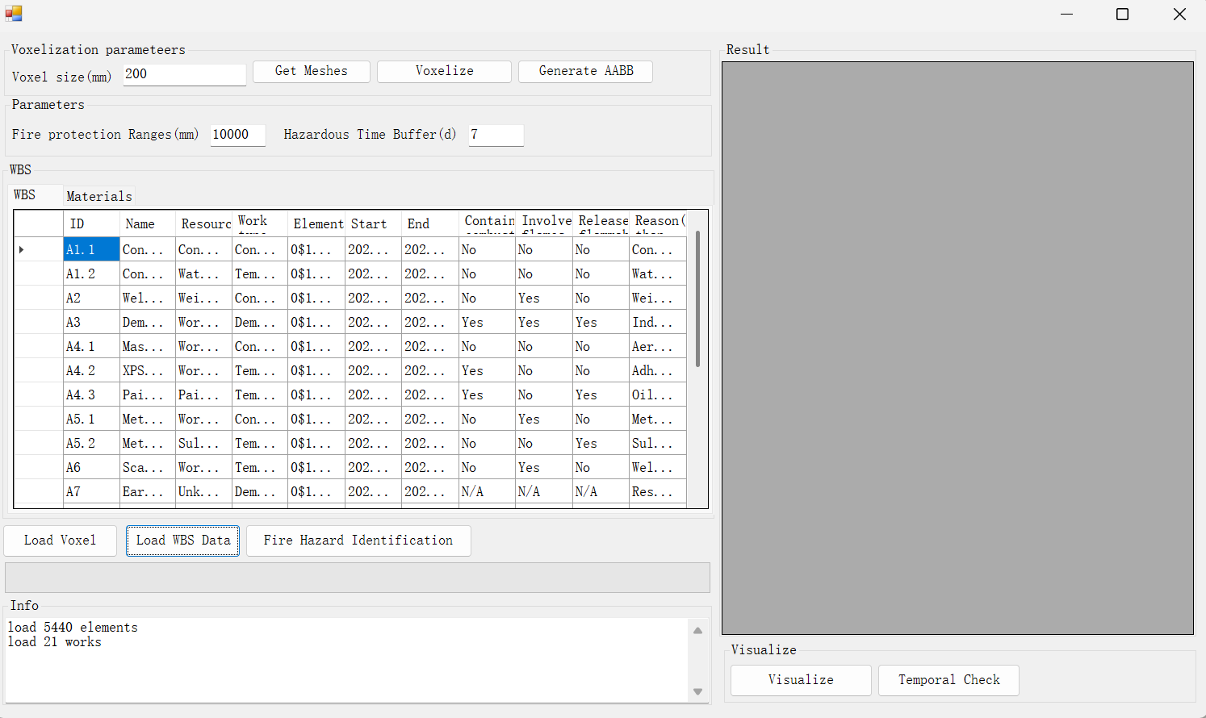
4 Running the tool
4th, Click the “Load WBS Data” button, choose the WBS file in csv formats. Wait until the data are loaded.

Slide 13
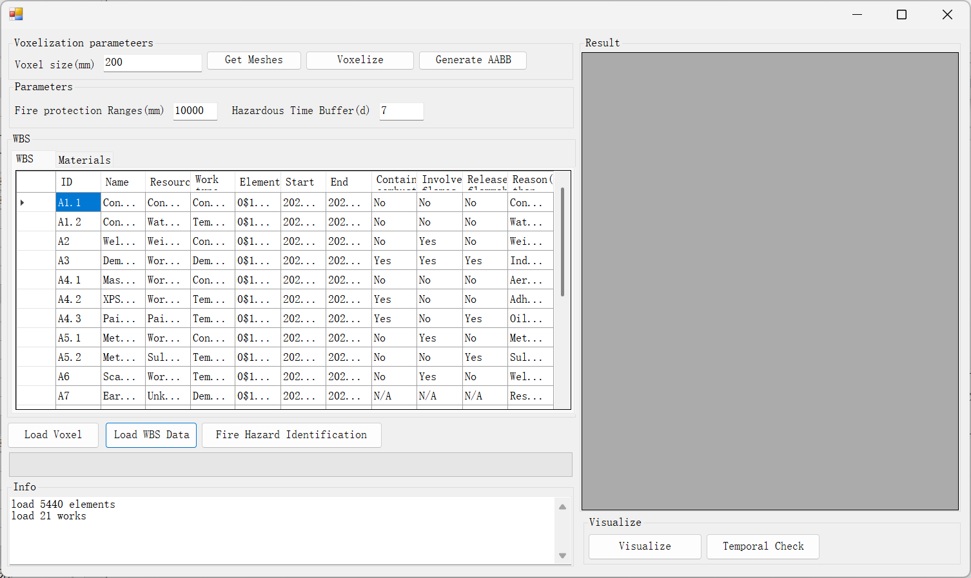
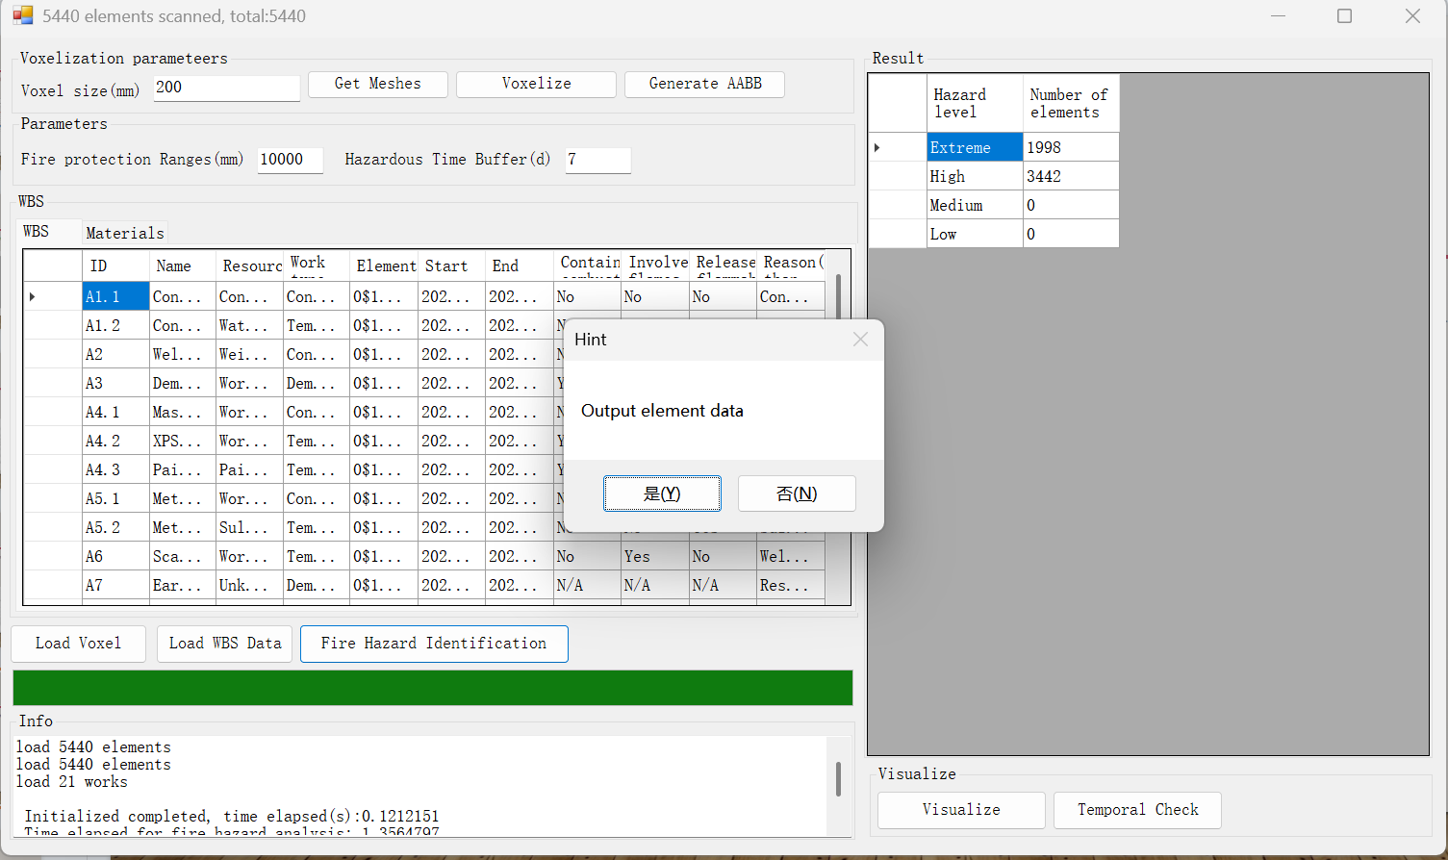
4 Running the tool
5th Click “Fire hazard Identification”. Wait until the process is over. You can save the result by clicking “Yes” of the pop-up dialogue for the validation check

Slide 14
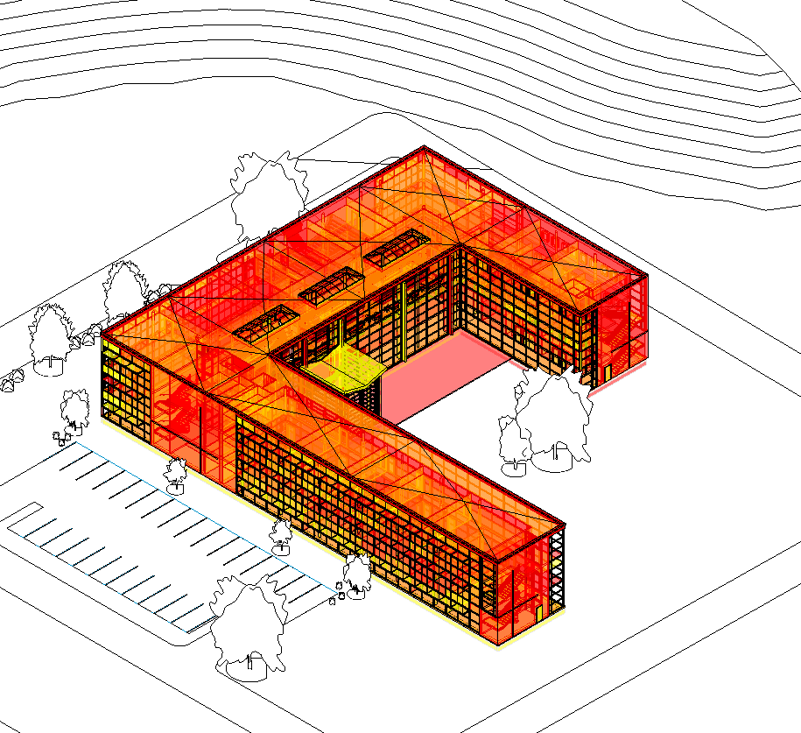
4 Running the tool
6th Click “Visualize” to check the colored representation of the model. Note: Data will only generated on the main model, the linked model, even voxelized, cannot attatch data.

Slide 15
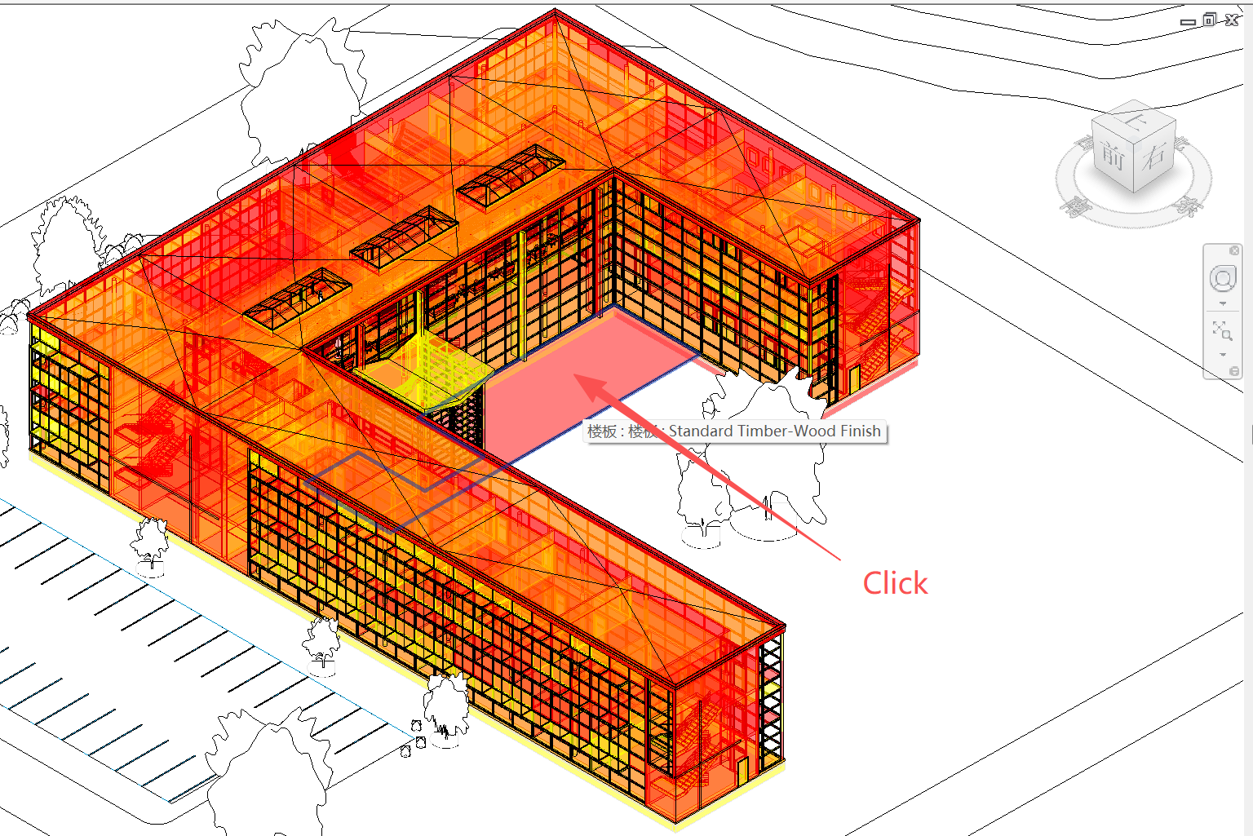
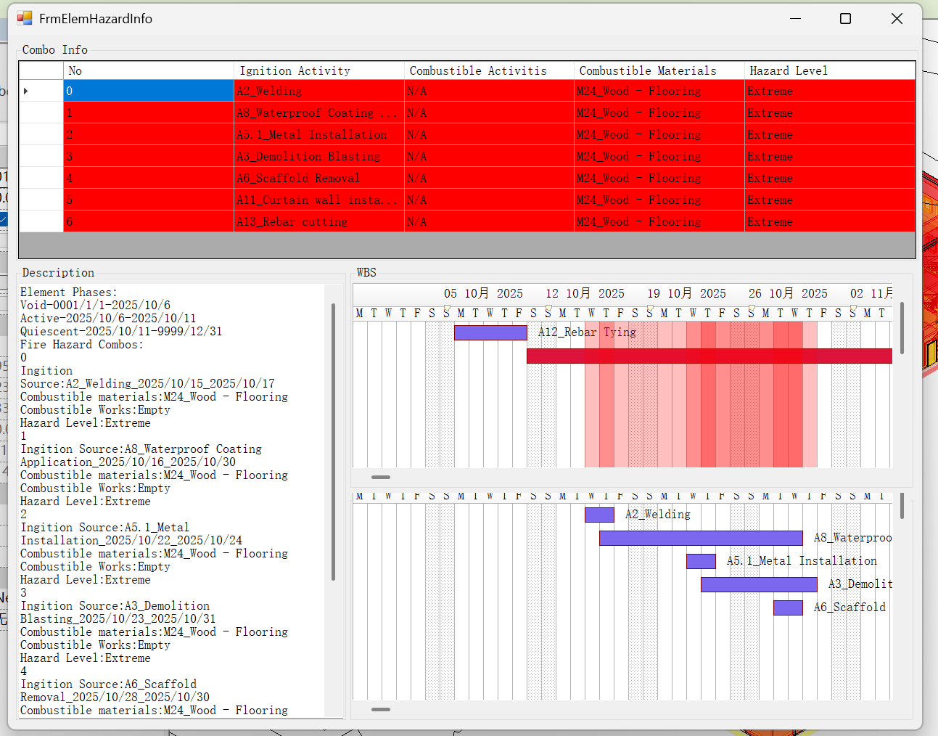
4 Running the tool
7th Click any element to check its detailed fire hazard information.

Slide 16
Thank you!

